Slide 1

Osteoarthritis Market Global Competitive Analysis
Comprehensive insights and strategic analysis on the global osteoarthritis market dynamics and competitive environment for investors.
AI-Generated Presentation • Confidential

Slide 2
Executive Summary
1
2
3
4
5
Market size
Growth drivers
Segmentation
Regional landscape
Competitive landscape
Global osteoarthritis market to reach USD 26.6 billion by 2035
Aging population, rising prevalence, and increasing demand for innovative therapies
Knee osteoarthritis is the largest and fastest-growing segment
North America leads the market, followed by Europe and Asia-Pacific
Major pharmaceutical companies dominate the market, while emerging biotech firms focus on regenerative therapies
2

Slide 3

Market trends
1
Increasing demand for innovative therapies and rising prevalence of osteoarthritis
Market Overview and Dynamics
Patient landscape
2
Global patient population is expected to grow, driven by an aging population
Competitive landscape
3
Major pharmaceutical companies dominate the market, while emerging biotech firms focus on regenerative therapies
Regional disparities
4
Significant differences in treatment access and healthcare infrastructure across regions
Growth opportunities
5
Emerging markets and innovative therapies offer growth opportunities
3

Slide 4
Key Market Statistics
MARKET SIZE
GROWTH RATE
PATIENT POPULATION
PREVALENCE
USD 7.5 billion to USD 11 billion by 2025
6.8% CAGR from 2020 to 2025
35% of the global population aged 65 and above
59.8% of the global population affected by osteoarthritis
4

Slide 5
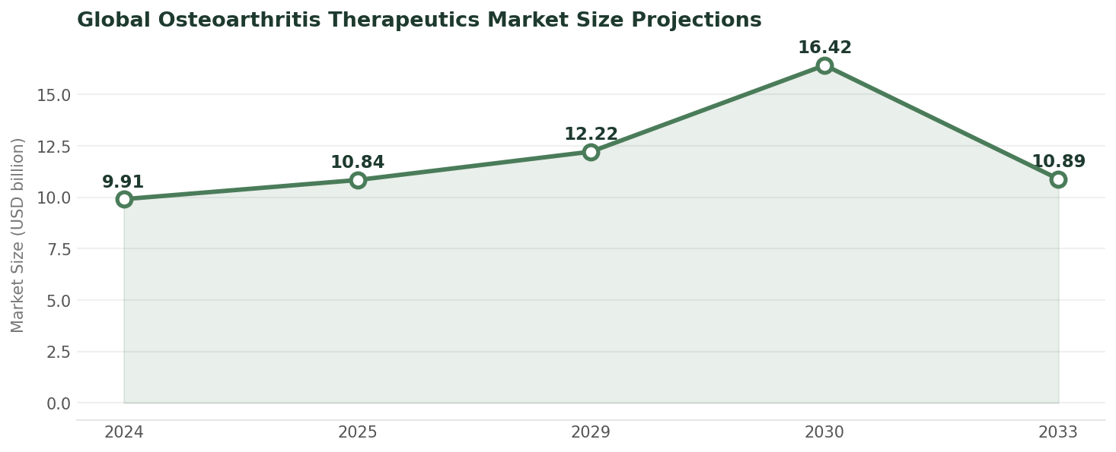
Global Osteoarthritis Therapeutics Market Size Projections
Data visualization from document analysis
📊
5

Slide 6
Regional Market Share Distribution
REGION
MARKET SHARE (%)
North America
35.1
Europe
28.0–47.0
Asia‑Pacific
21.0
3 records · 2 metrics · Source: Document Analysis
6

Slide 7
Competitive Landscape
01
02
03
04
Major players
Emerging players
Market trends
Growth strategies
Pfizer, Johnson & Johnson, and other pharmaceutical companies
Biotech firms focusing on regenerative therapies
Increasing demand for innovative therapies and rising prevalence of osteoarthritis
Partnerships, acquisitions, and innovative product development
7

Slide 8

Company overview
1
Pfizer is a leading pharmaceutical company with a diversified portfolio
Pfizer Inc. Detailed Competitive Assessment
Product portfolio
2
Pfizer has a range of osteoarthritis treatments, including pain management and disease-modifying therapies
Market share
3
Pfizer has a significant market share in the osteoarthritis market
Growth strategies
4
Pfizer is focused on innovative product development and strategic partnerships
Challenges
5
Pfizer faces challenges from emerging biotech firms and increasing competition
8

Slide 9
Market Evolution and Milestones
Emerging biotech firms started to focus on regenerative therapies
Innovative therapies are expected to drive market growth
2020
2025
2030
Osteoarthritis market size reached USD 7.5 billion
2022
Market size is expected to reach USD 11 billion
2027
Osteoarthritis market is expected to reach USD 20 billion
9

Slide 10
Osteoarthritis Market to Reach USD 26.6 Billion by 2035
The osteoarthritis market is expected to reach USD 26.6 billion by 2035
Growth rate: 9.5% CAGR from 2025 to 2035
Market drivers: Aging population, rising prevalence, and increasing demand for innovative therapies
10

Slide 11
Market Entry Barriers and Opportunities
Regulatory barriers
Competition
Innovation
Partnerships
Stringent regulatory requirements for new treatments
High competition from established pharmaceutical companies
Opportunities for innovative therapies and treatments
Opportunities for partnerships and collaborations with emerging biotech firms
11

Slide 12

Conclusion
→
The osteoarthritis market is expected to reach USD 26.6 billion by 2035
→
Growth drivers: Aging population, rising prevalence, and increasing demand for innovative therapies
→
Competitive landscape: Major pharmaceutical companies dominate the market, while emerging biotech firms focus on regenerative therapies
→
Growth opportunities: Emerging markets and innovative therapies offer growth opportunities
→
Challenges: Regulatory barriers, competition, and reimbursement challenges
12

